Slide 1
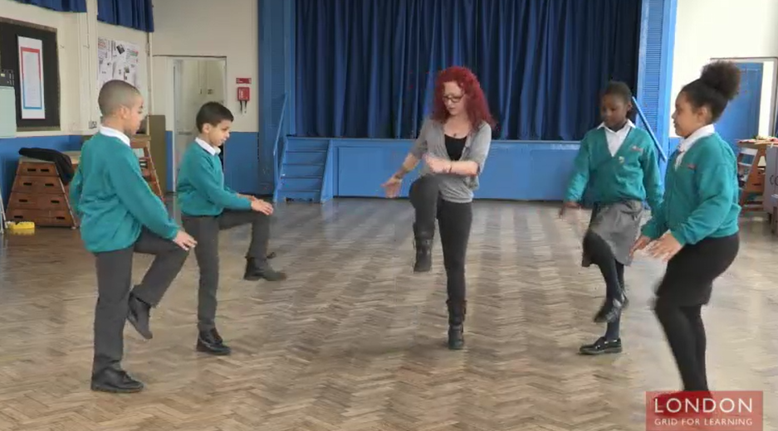
LGfL Movement Break Examples

Slide 2
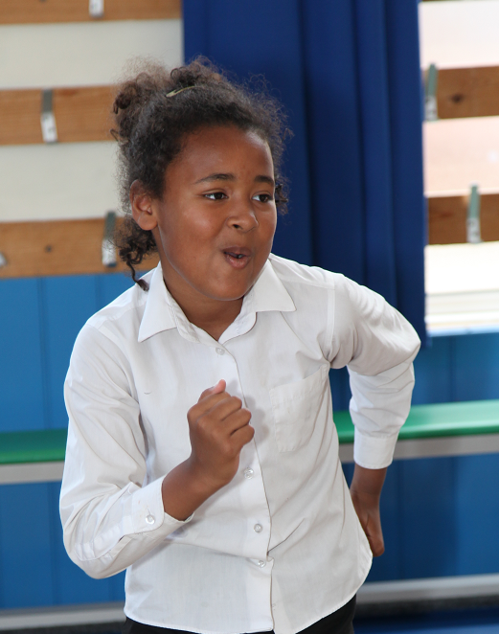
Before you start with the movement break sequences
Please read all the information in the Introduction to Movement Breaks section before you start.

Slide 3
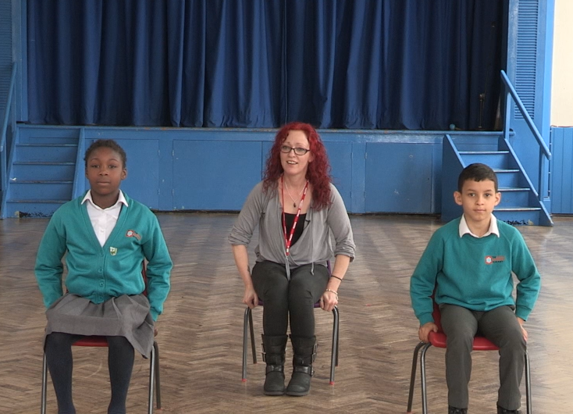
Examples of Resistance and Weight Bearing Movement Breaks - Shown in Videos
Example 1 Solo Movement Break:
Push up against a chair x 5
Stand up and stretch to the ceiling for 10 seconds
Stretch to the left side for 10 seconds
Stretch to the right side for 10 seconds
Make a bug position and stand up out of position 5 times
Arm circles for 10 seconds both ways
Stand up and stretch to the ceiling for 10 seconds

Slide 4
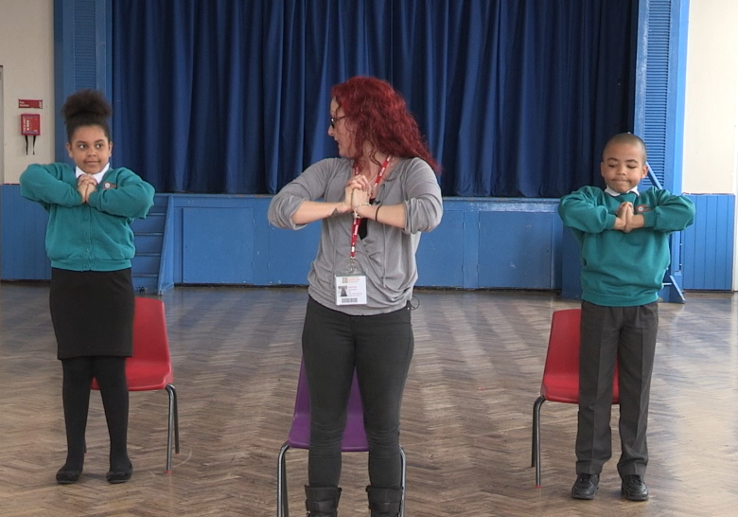
Examples of Resistance and Weight Bearing Movement Breaks – Shown in Videos
Example 2 Solo Movement Break:
Stand up and stretch to the ceiling for 10 seconds.
Push hands together and squeeze for 10 seconds
Stand in tree position (stand on 1 leg with other foot balanced on standing leg) for 10 seconds. Repeat on other side.
March on spot for 10 seconds
Stand up and stretch to the ceiling for 10 seconds.

Slide 5
Examples of Advanced Movement Breaks - Shown in Videos
Example 3 Solo Movement Break (more advanced):
1. Stand up and stretch to the ceiling for 10 seconds.
2. Chair squats to standing x 10.
3. Bend forward hinging from waist with arms outstretched and back 5 times.
4. Back stretch with arms stretched out for 10 seconds.
5. Stand up and stretch to the ceiling for 10 seconds.

Slide 6
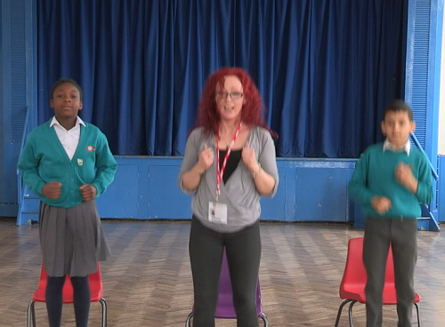
Examples of Alerting Movement Breaks - Shown in Videos
Example 4 Solo Movement Break (more alerting):
1. Stand up and stretch to the ceiling for 10 seconds.
2. Jump up and down 10 times.
3. Bring knee up and touch with opposite hand 10 times.
4. Chair squats to stand 10 times.
5. Fast marching on spot for 10 seconds.
6. Stand up and stretch to the ceiling for 10 seconds.

Slide 7
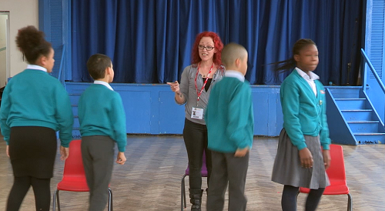
Examples of Paired Movement Breaks - Shown in Videos
Example 5 Paired Movement Break :
1. Stand up and stretch to the ceiling for 10 seconds.
2. Stand back to back and high five each other whilst twisting around 10 times.
3. Make an arch with your arms with a partner and push and relax 3 times.
4. Carry out clapping sequence with high fives and then low fives 10 times over.
5. Stand up and stretch to the ceiling for 10 seconds.

